Slide 1
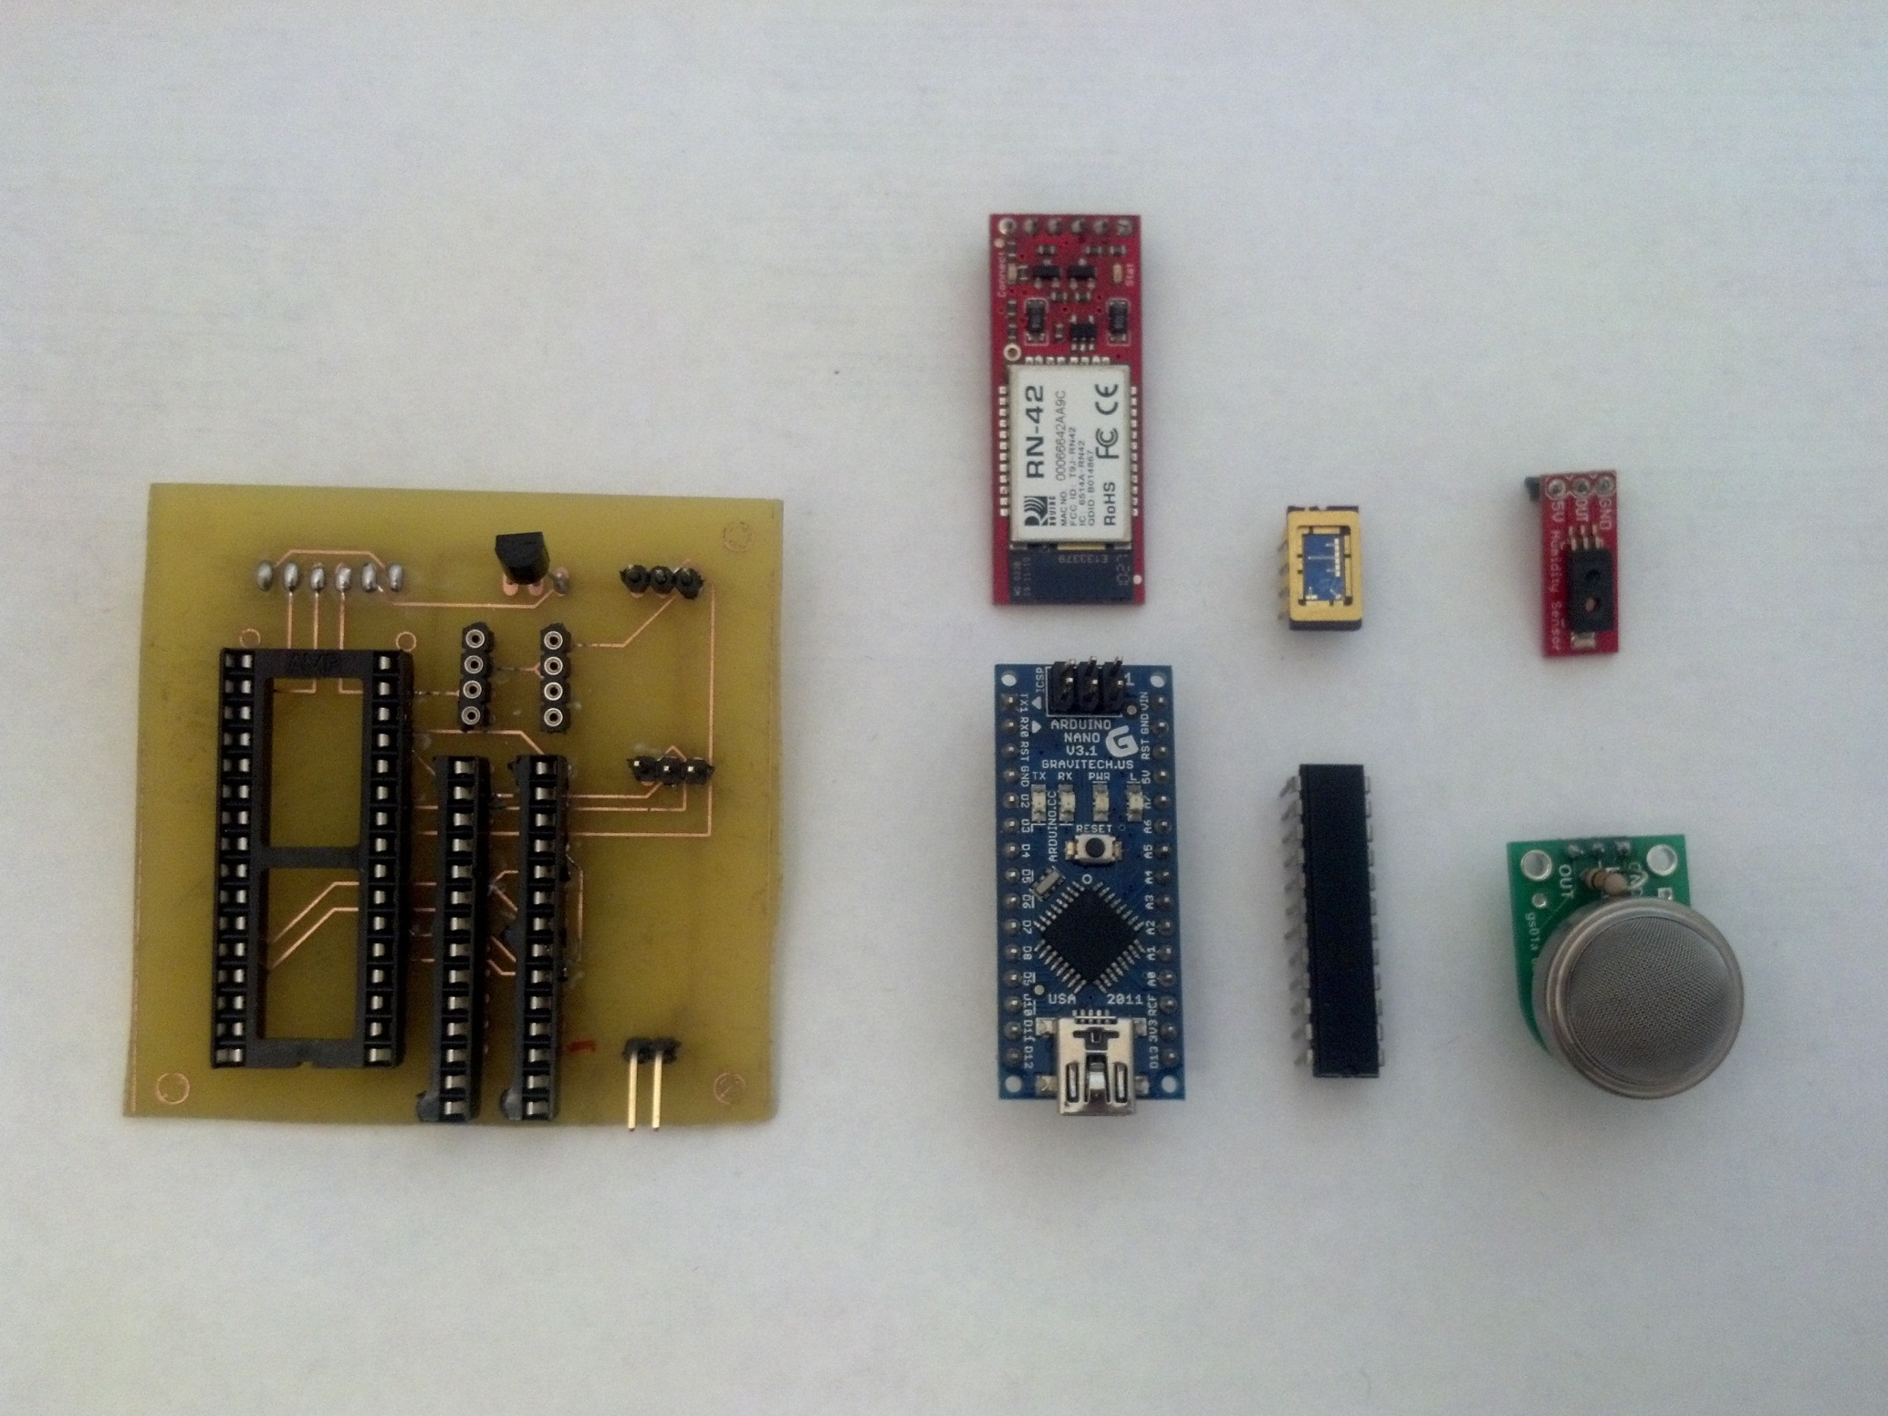
Bluetooth Module
Nano Sensor
Humidity Sensor
Temperature Sensor
Digital Potentiometer
PCB
Arduino Microcontroller
Commercial H2S Sensor

Slide 2
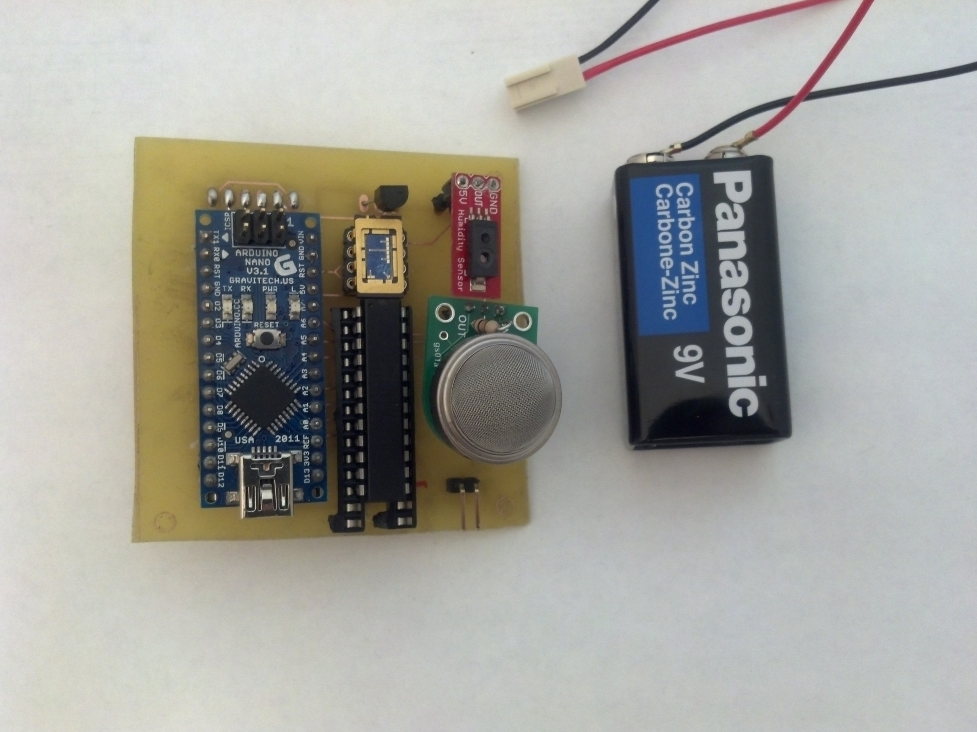
Battery
Fully Assembled Device

Slide 3
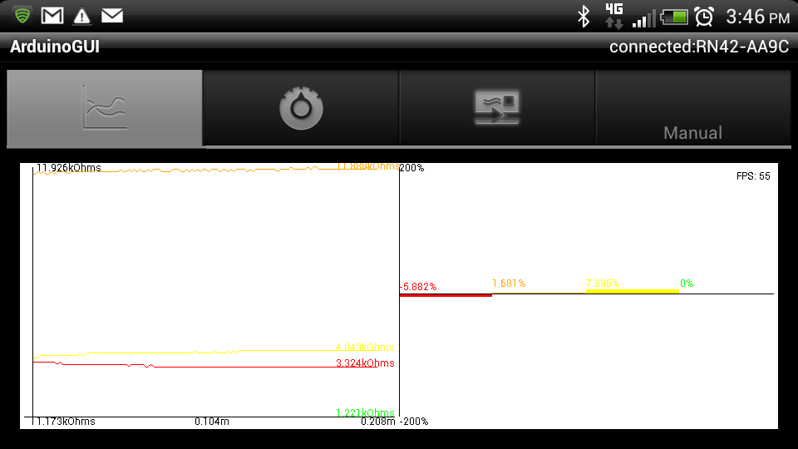
Nano Sensor

Slide 4
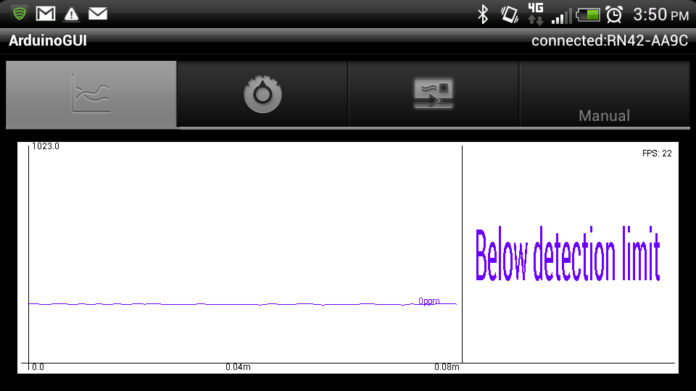
Commercial H2S Sensor

Slide 5
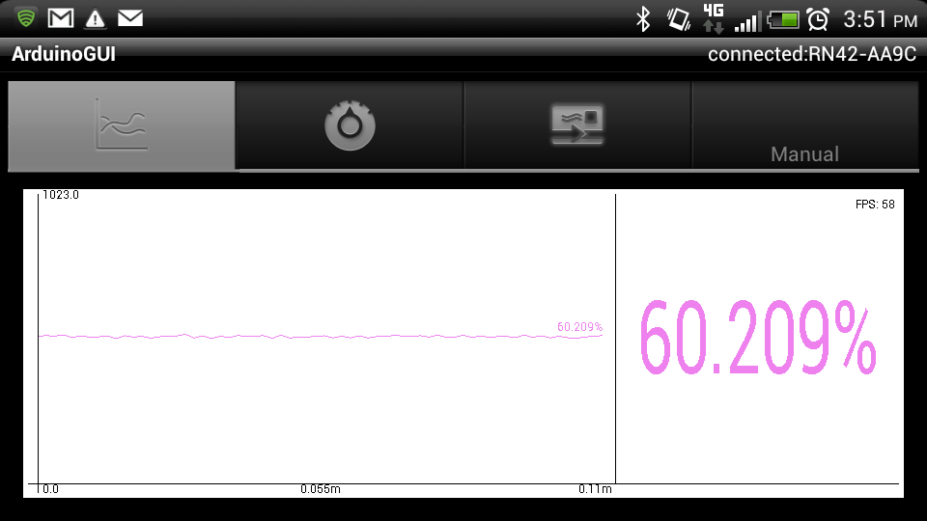
Humidity Sensor

Slide 6
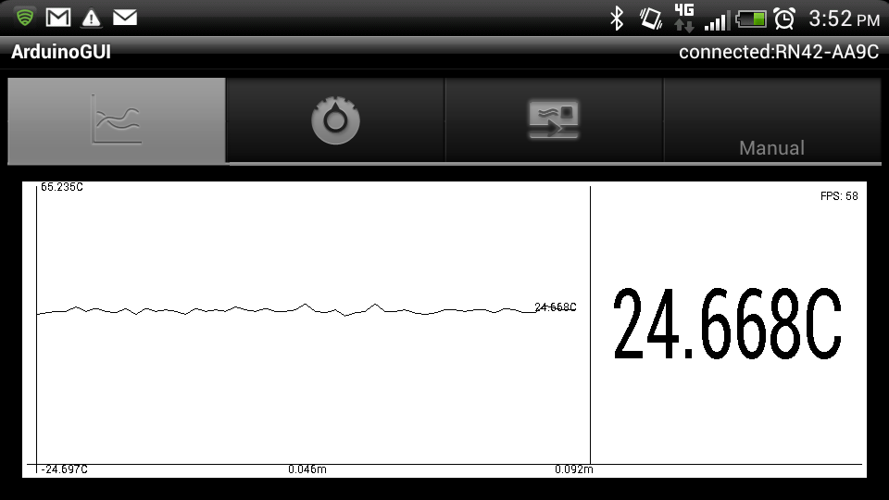
Temperature Sensor

Slide 7
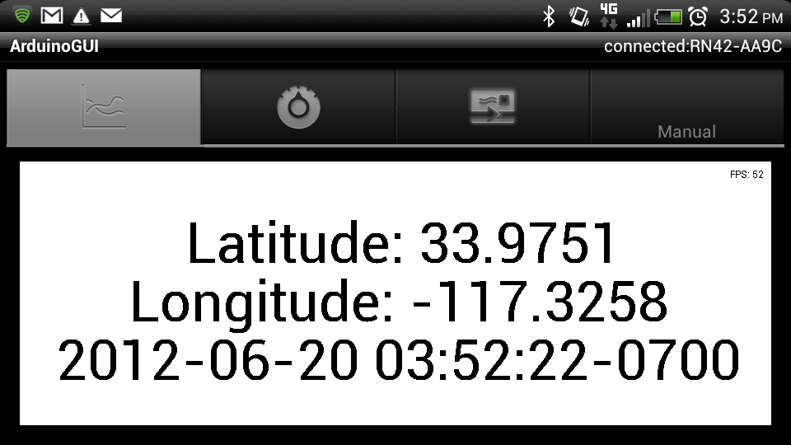
GPS Data

